Slide 1

GuideSense
Your Trusted Navigation Companion
Team: Power Angers
Sprint 1

Slide 2
Agenda
1
2
3
Team Member
6
Diagrams
Project Overview
7
Sprint 1 Recap
Technologies & Tools
8
Burndown Chat
4
Team Logistics
9
Sprint 2 – Spring planning
5
MVP
10
Project Demo

Slide 3
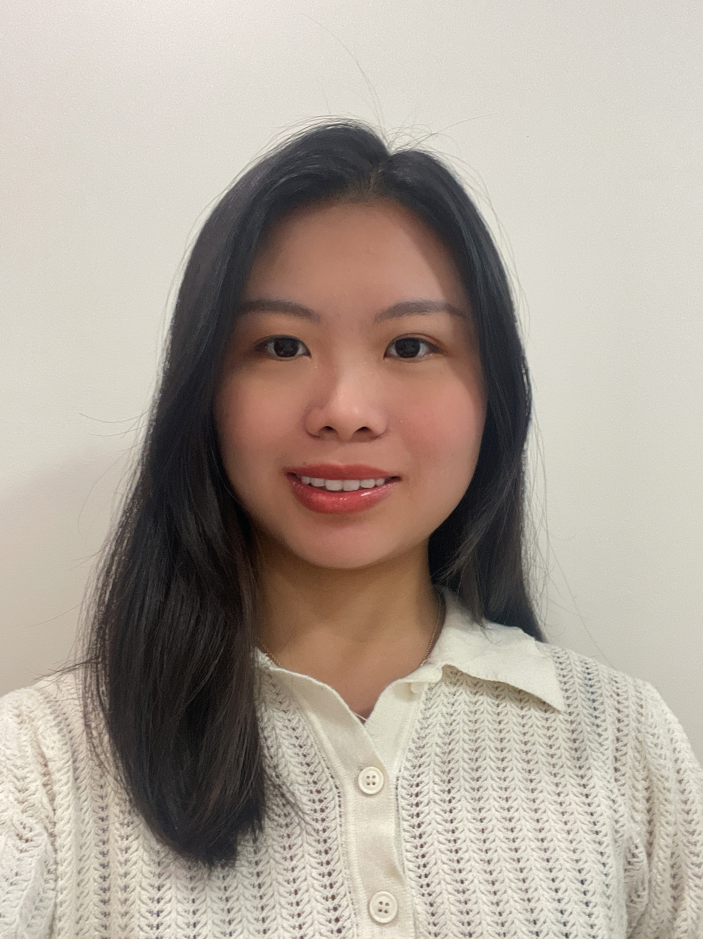
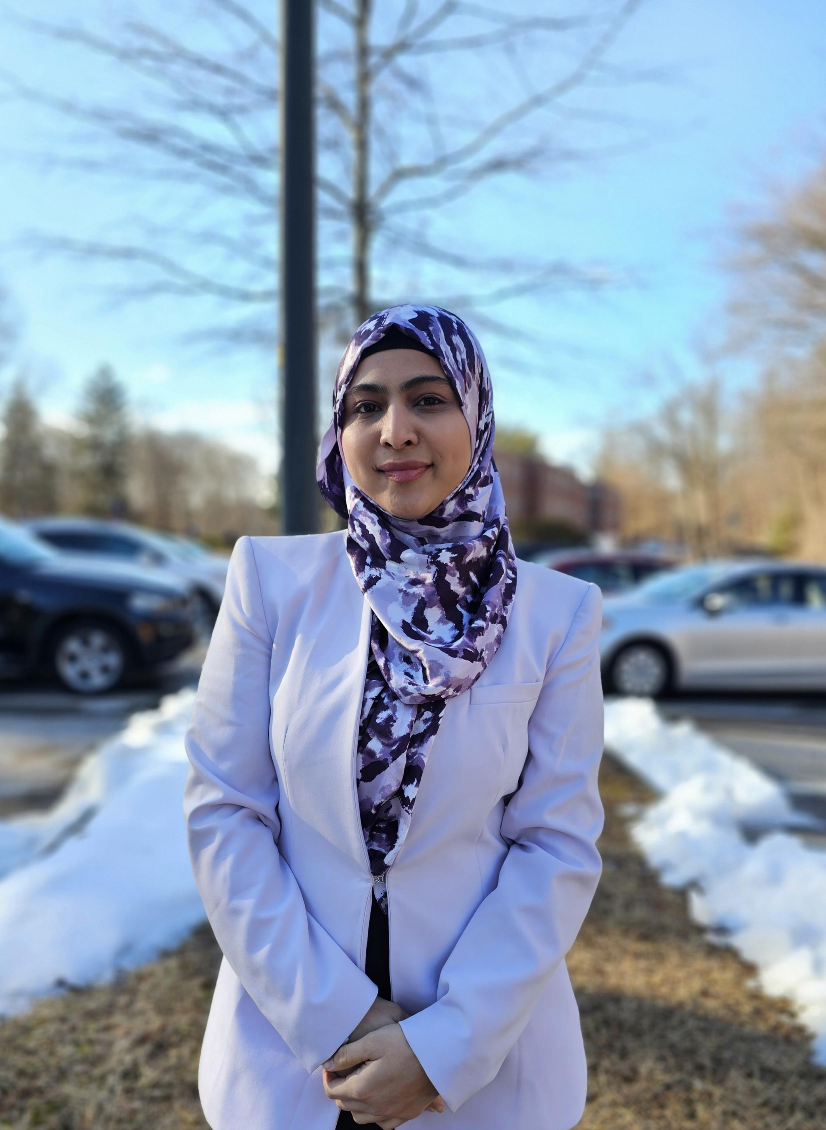
Power Anger
Afziya Waknis
Kaiyin Chen
Project Manager/
Developer
Aw14091n@pace.edu
Database Administrator
Kaiyin.chen@pace.edu
**Improved based on Professor's feedback

Slide 4


Power Anger
Ritesh Singh
Dinesh Gopi Sunkara
Developer
Ritesh.singh@pace.edu
Developer
Ds46669n@pace.edu
**Improved based on Professor's feedback

Slide 5
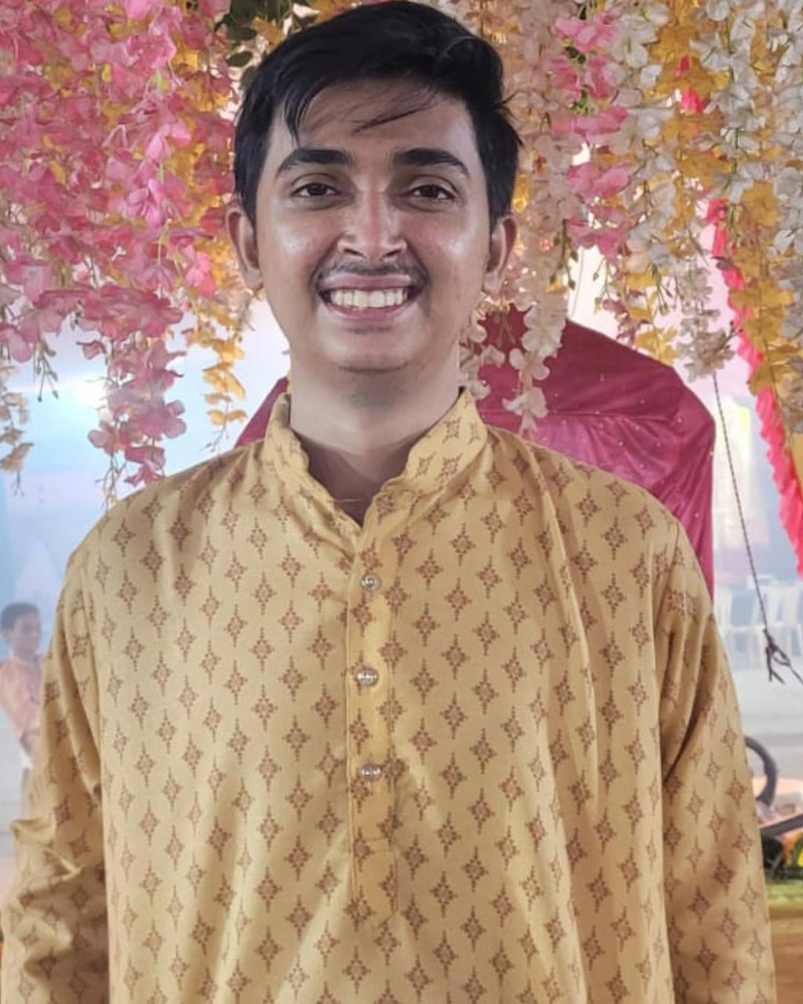
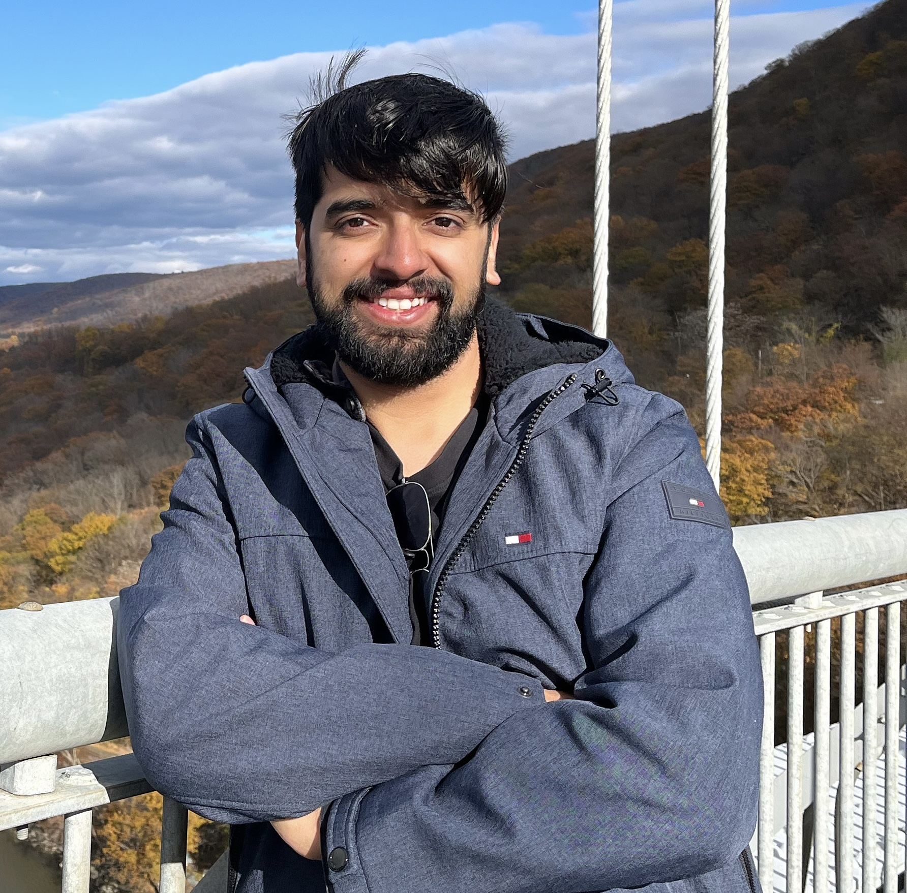
Power Anger
Rushabh Makwana
Vaibhav Thapliyal
Developer Lead
Frontend Developer
Vaibhav.thapliyal6@gmail.com
Backend Developer
Rm36294n@pace.edu

Slide 6
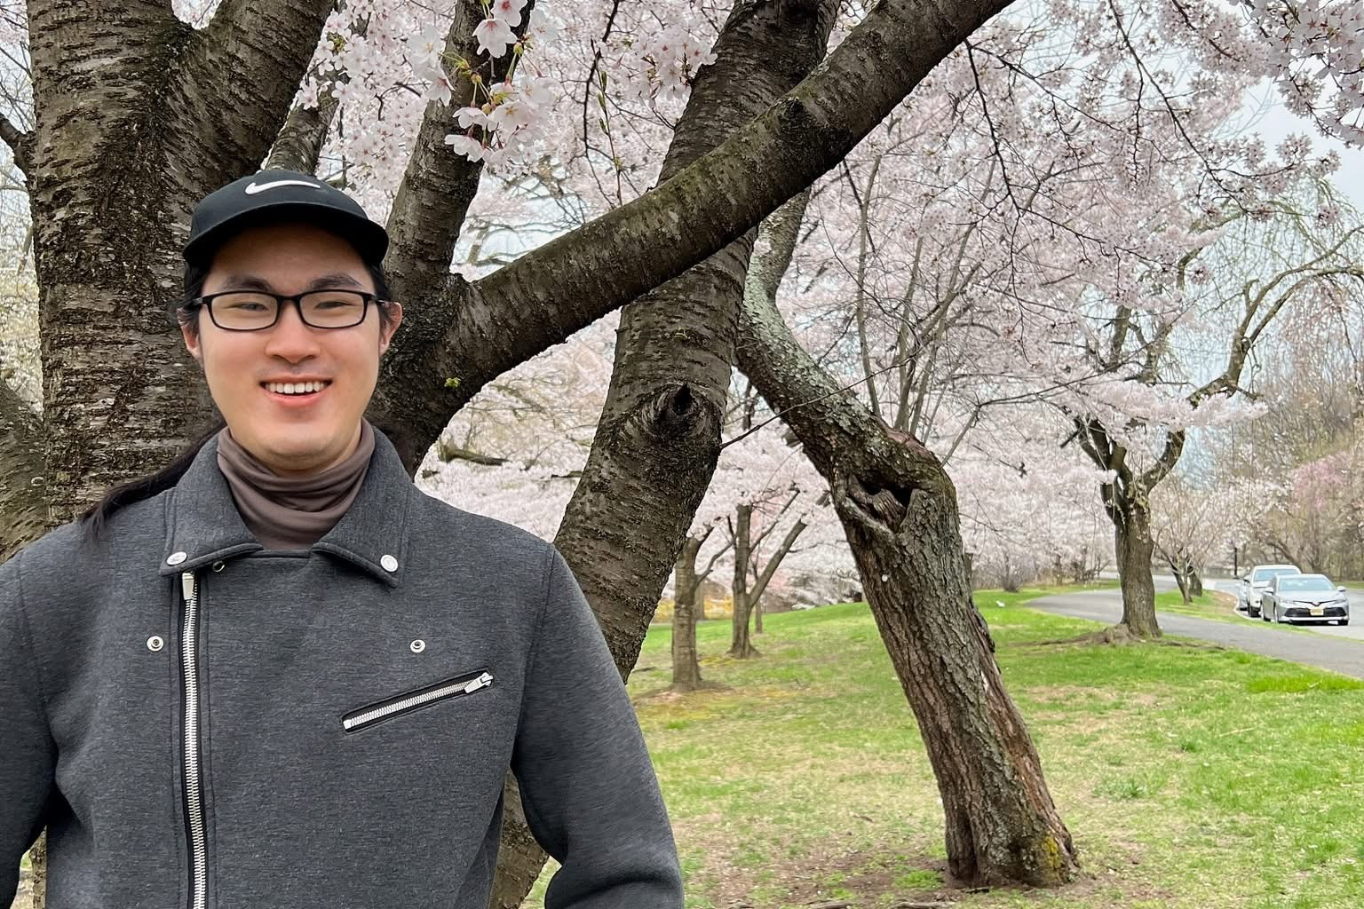
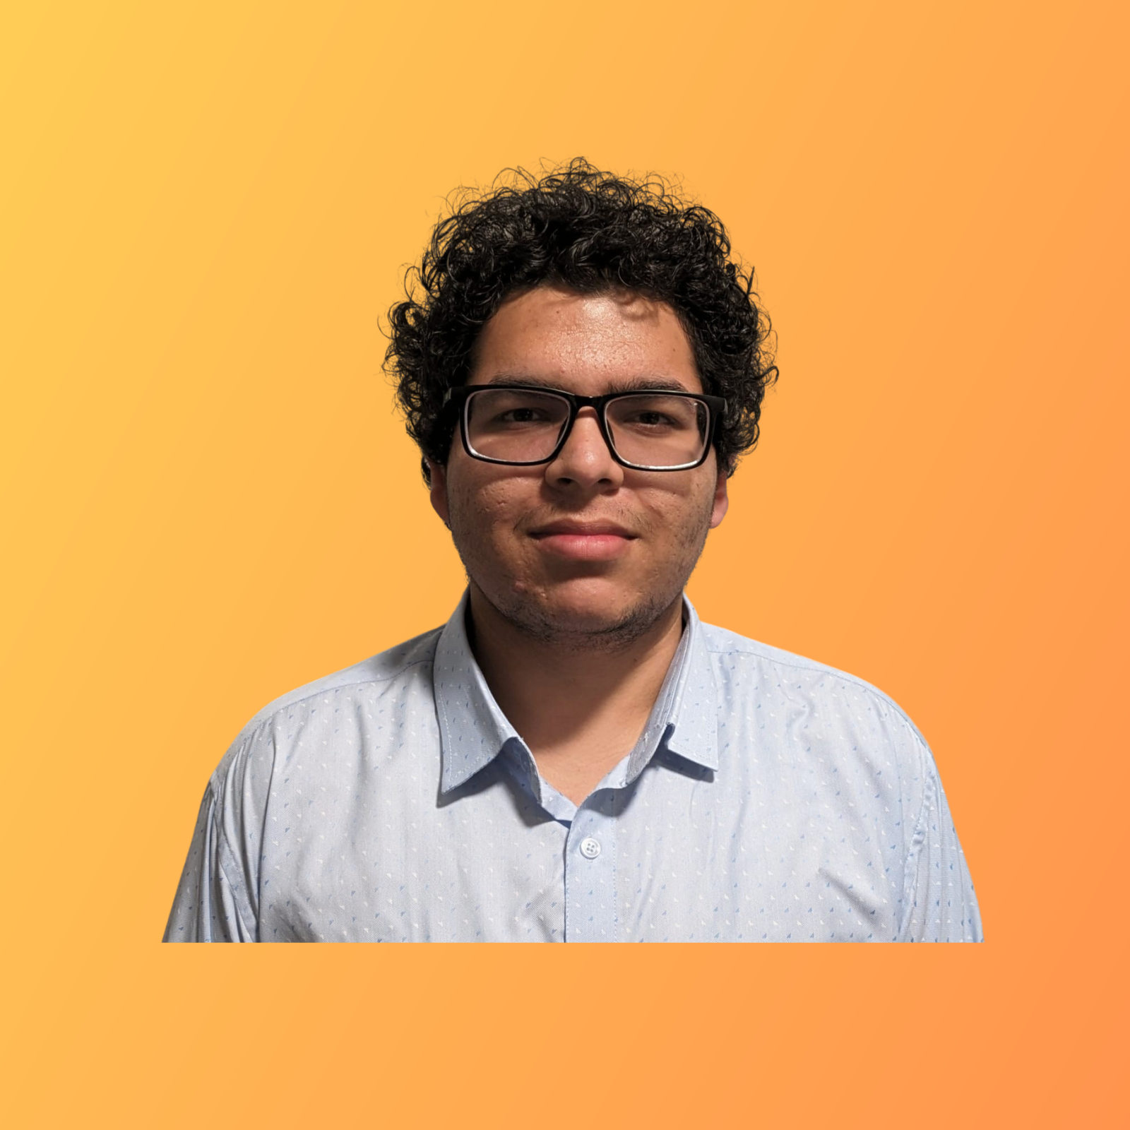
Power Anger
Min Jung
Hrishikesh Shah
Quality Analyst
Mj34564n@pace.edu
Frontend Developer
Hs75142n@pace.edu

Slide 7
Problem Statement
Navigating through everyday environments presents significant challenges for blind and visually impaired individuals., moving vehicles, and the lack of real-time guidance.
Traditional mobility aids like canes and guide dogs, while helpful, often fall short in providing comprehensive and real-time information about obstacles, directions, and surroundings.
This lack of real-time situational awareness can lead to increased risks of accidents and restrict the independence of visually impaired individuals.
Therefore, there is a pressing need for an innovative solution that leverages modern technology to enhance mobility and safety for the visually impaired community.
This project aims to create a web app that uses object detection and voice commands to help blind people navigate safely by warning them about obstacles, giving directions, and describing their surroundings in real time.

Slide 8
Project Description
This innovative web app leverages computer vision and machine learning to provide real-time audio guidance, identifying objects, obstacles, and crosswalks for the blind and visually impaired.
Combining GPS and AI object detection, it aims to make it easier and safer for blind people to get around independently, especially in cities and outdoor areas.
The goal is to provide a helpful, accessible, and dependable way for visually impaired people to navigate.
Key features of the application include:
Real-time Object Detection
Voice Navigation and Alerts
GPS Integration
User-Friendly Interface

Slide 9
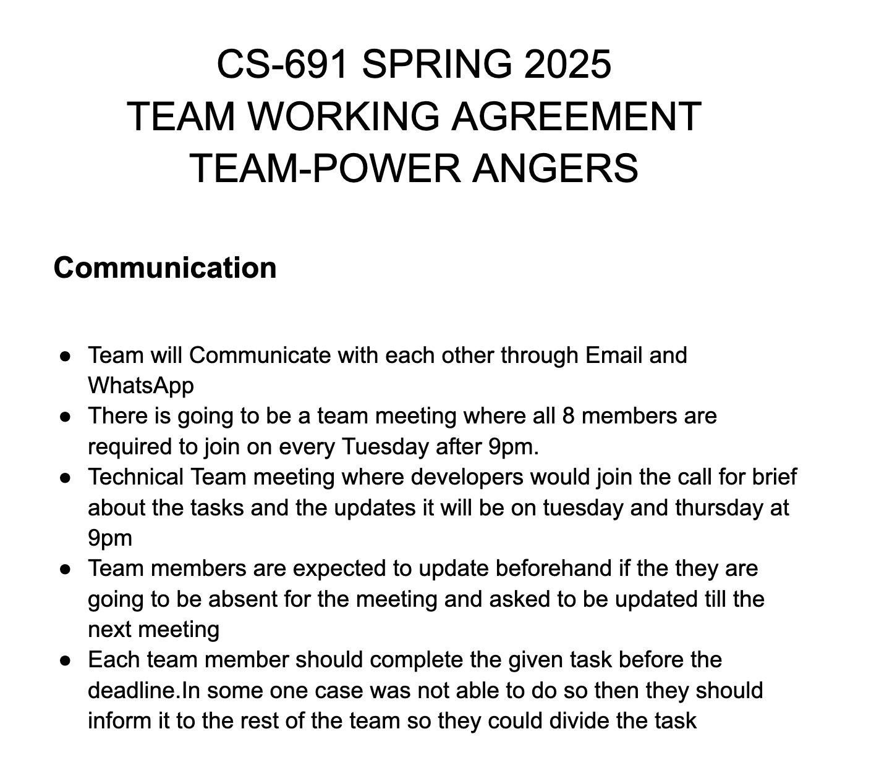
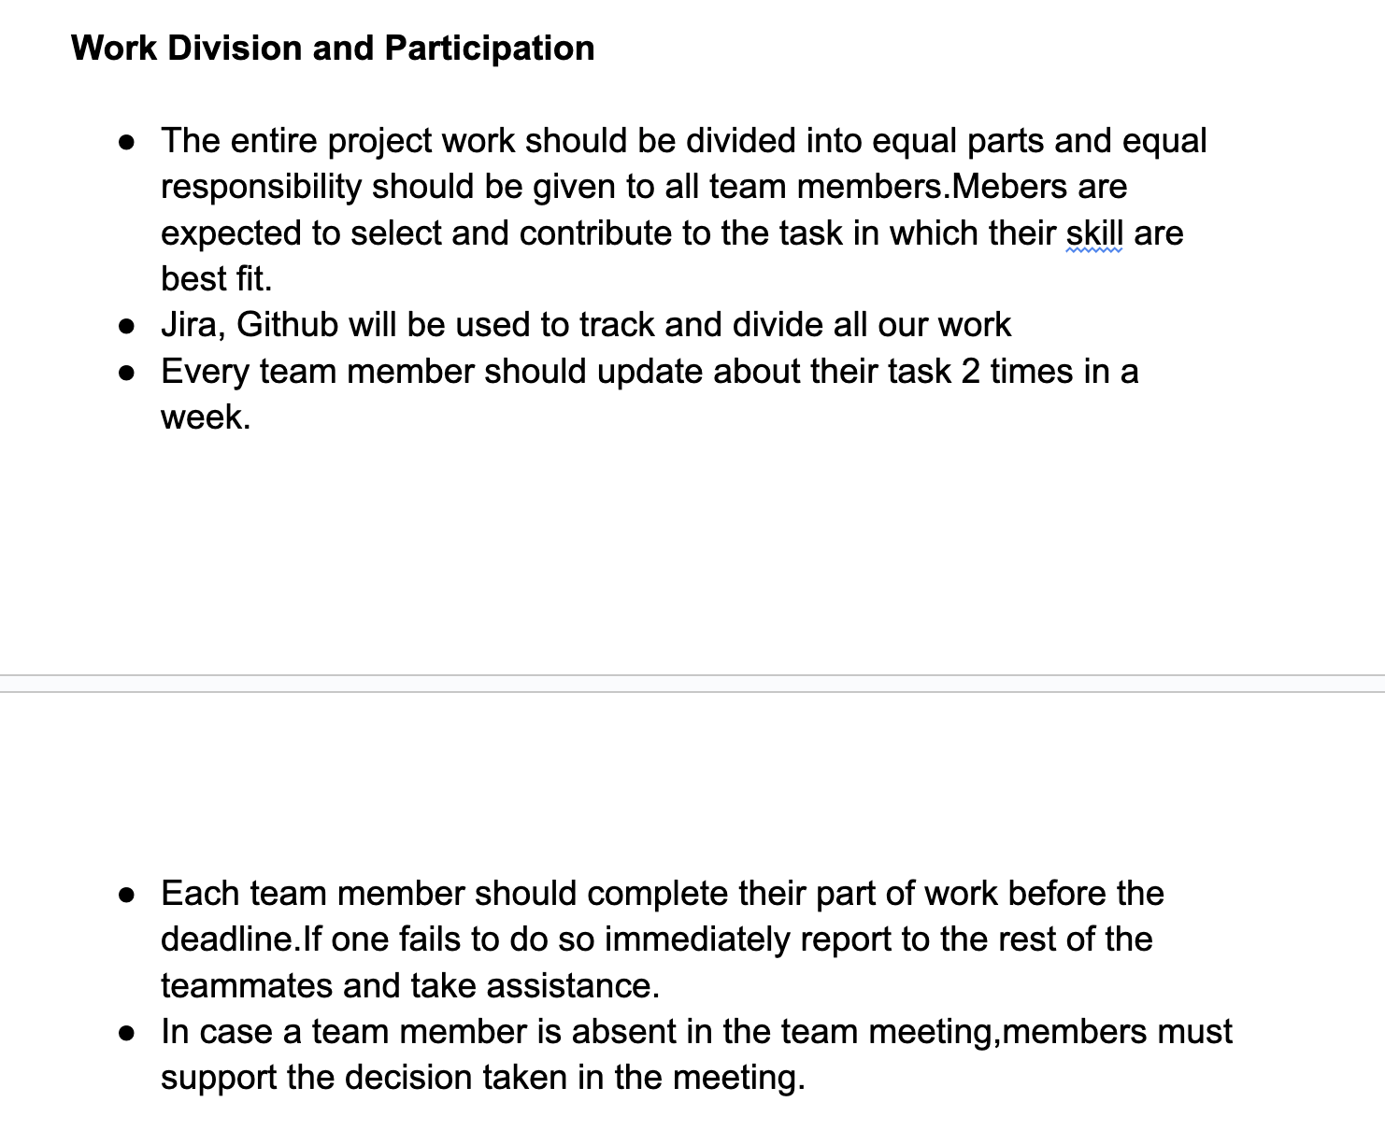
Team Working Agreement

Slide 10
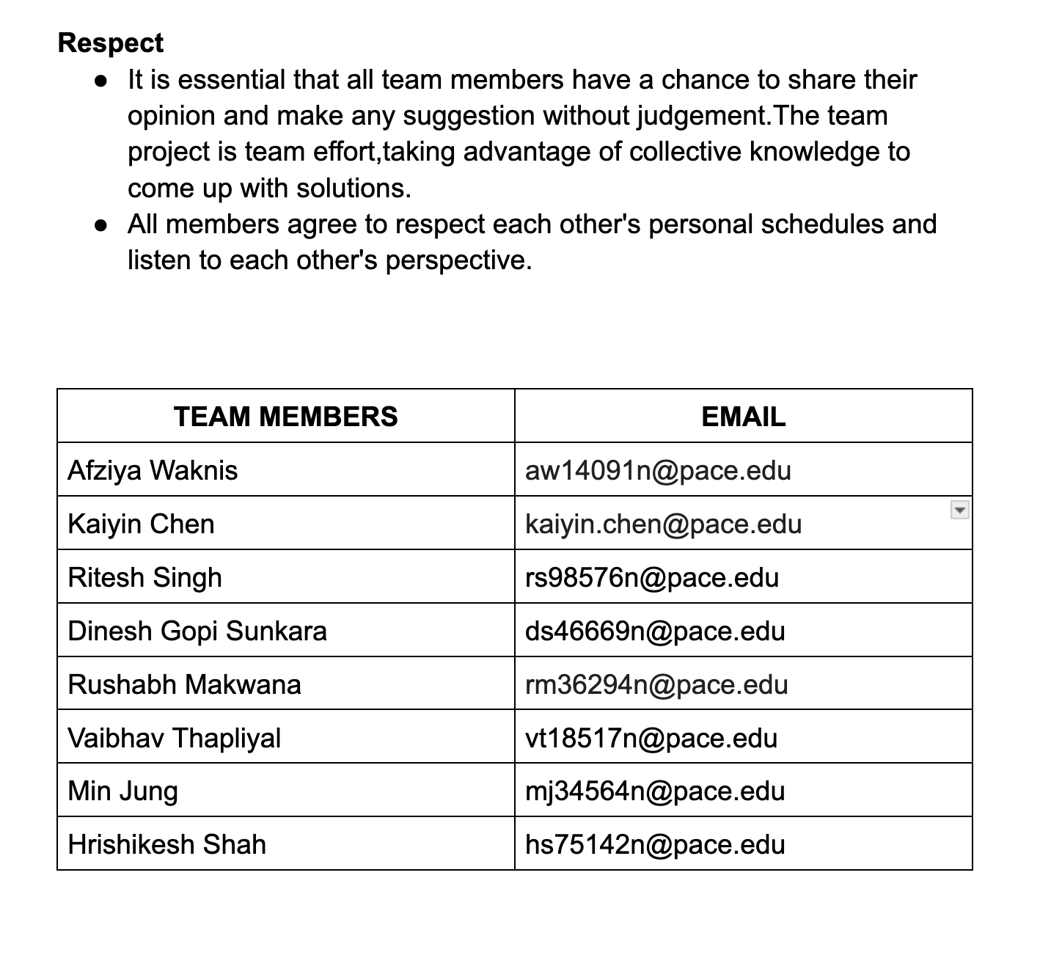
Team Working Agreement

Slide 11
Project Schedule
Sprint 0
Sprint 1
Sprint 2
Sprint 3
1/21/2025 - 2/10/2025
2/11/2025 - 3/10/2025
3/11/2025 - 4/7/2025
4/8/2025 - 4/28/2025
Daily Scrum
Scrum Planning
Retrospective
MVP (Authentication, YOLO, Map)
Design Diagrams
Daily Scrum
Scrum Planning
Retrospective
Final product
Daily Scrum
Retrospective
Deliverable – Persona, tech & tool, stories breakdown
Daily Scrum
Scrum Planning
Retrospective
Connect Users
Connect all components
Text to Speech
**Improved based on Professor's feedback

Slide 12

Persona One: The Independent Blind User
Name: Aisha Khan
Age: 32
Occupation: Software Developer (works remotely)
Background: Aisha has been blind since birth. She is highly tech-savvy and relies on assistive technology. She is motivated to use tools that enhance her independence and streamline daily activities.
App Usage Scenario: Aisha wants to use the app for navigation while walking, especially in unfamiliar areas, and identify objects which could be a barrier for seamless tasks.
Needs: Seamless integration with existing assistive technologies (screen readers, voice control), accurate location services, reliable information about accessible routes and environments, and robust privacy features.
Goals: Increased independence, improved access to information, enhanced safety while navigating, and streamlined daily task management.

Slide 13
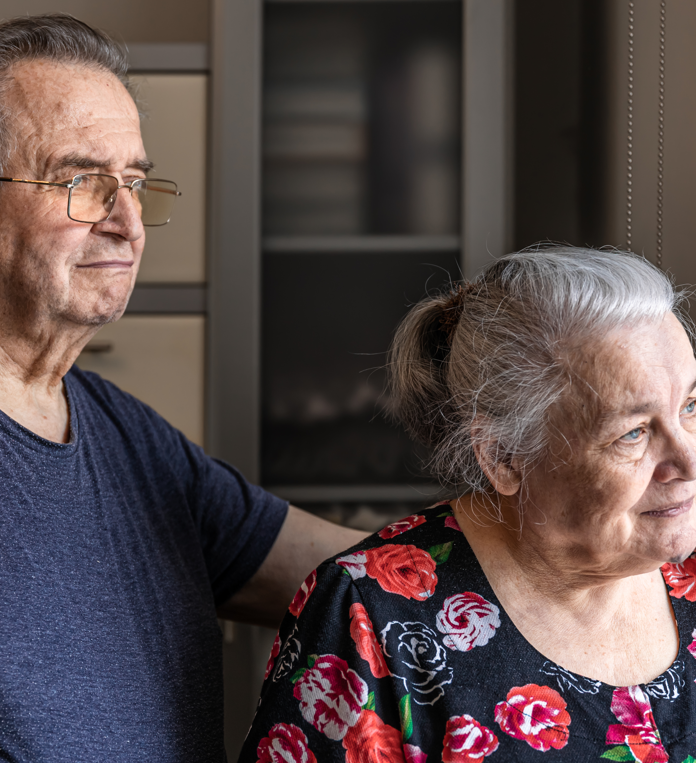
Persona Two: The Concerned Family Member
Name: Robert Chen
Age: 65
Relationship: Son of a visually impaired senior
"I worry about my mother's safety. I hope this app can help me stay connected and ensure she's doing okay."
Background: Robert's mother is losing her vision due to macular degeneration. He lives in a different city and wants to stay connected and provide support remotely.
App Usage Scenario: Robert wants to use the app to track his mother's location (with her consent), receive alerts if she deviates from her usual routes, remotely assist her with tasks like medication reminders, and communicate with her easily through the app's accessible interface.
Needs: User-friendly interface, reliable location tracking (with privacy safeguards), remote assistance features, accessible communication tools, and clear instructions for setup and use.
Goals: Increased peace of mind, improved communication with his mother, ability to provide remote support, and enhanced safety for his visually impaired parent

Slide 14
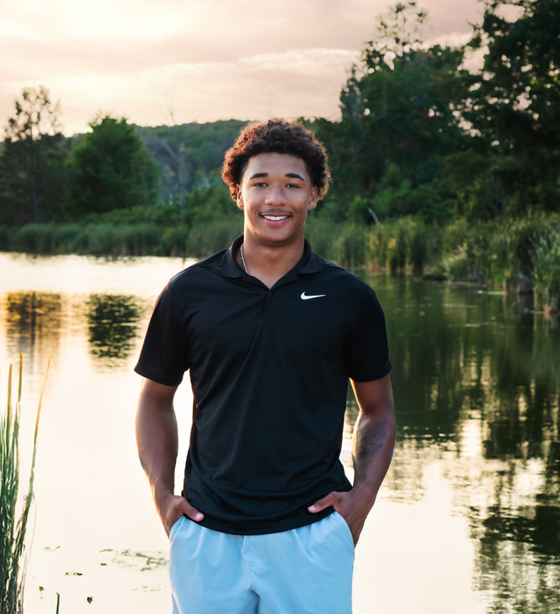
Persona Three : Partially sighted Teenager
Name: David Miller
Age: 16
Background: David has low vision due to a genetic condition. He can see some things with the aid of glasses or magnifiers.
"I want to be able to do the same things my friends do. I hope this app can help me navigate more easily and access information."
App Usage Scenario: David wants to use the app to magnify text and images, identify colors, navigate public transportation, and access audio descriptions of videos and other media. He needs an app that is easily customizable to his specific visual needs.
Needs: Customizable display settings (font size, contrast, color schemes), reliable object and text recognition features, seamless integration with magnification tools, and accessible interface that can be used with limited vision.
Goals: Increased independence, improved access to information, enhanced social participation, and greater confidence in navigating the world.

Slide 15










Technologies & Tools
Programming Language
Database
Tools

Slide 16
AI Model
YOLO, which stands for ‘You Only Look Once,’ is a state-of-the-art object detection model known for its real-time speed and accuracy.
Real-time Speed: Processes the entire image in a single pass, making it one of the fastest models for object detection.
Grid-Based Detection: Divides the image into a grid, with each cell responsible for detecting objects within it.
Accurate Bounding Boxes: Predicts precise bounding boxes and confidence scores for each detected object.
Pre-trained on COCO: Leverages the massive COCO dataset (80 object categories, 200,000+ images) for robust and accurate general object detection
Refined Results: Uses Non-Maximum Suppression (NMS) to eliminate overlapping detections and ensure only the most accurate results are shown.

Slide 17
MVP
1
3
Object Detection
Object detection in real time
2
Google Map API
Route detection
User Authentication
Sign Up / Sign In

Slide 18
MVP
A client (web browser) connects to the server and sends a WebRTC offer
The server sets up a peer connection, processes the offer, and sends back an answer
When video starts streaming from the client, each frame is: - Received by the server - Processed through YOLO (object detection) - Enhanced with visual indicators (boxes around objects) - Sent back to the client in real-time

Slide 19
Frameworks /APIs
FastAPI: FastAPI is a modern, high-performance web framework for building APIs with Python.
WebRTC: WebRTC is open-source tech for direct browser-to-browser communication without plugins. It powers peer-to-peer applications with minimal overhead.
Google Maps API: https://developers.google.com/maps/apis-by-platform
Notes:
FastAPI: "/offer" to establish a connection

Slide 20
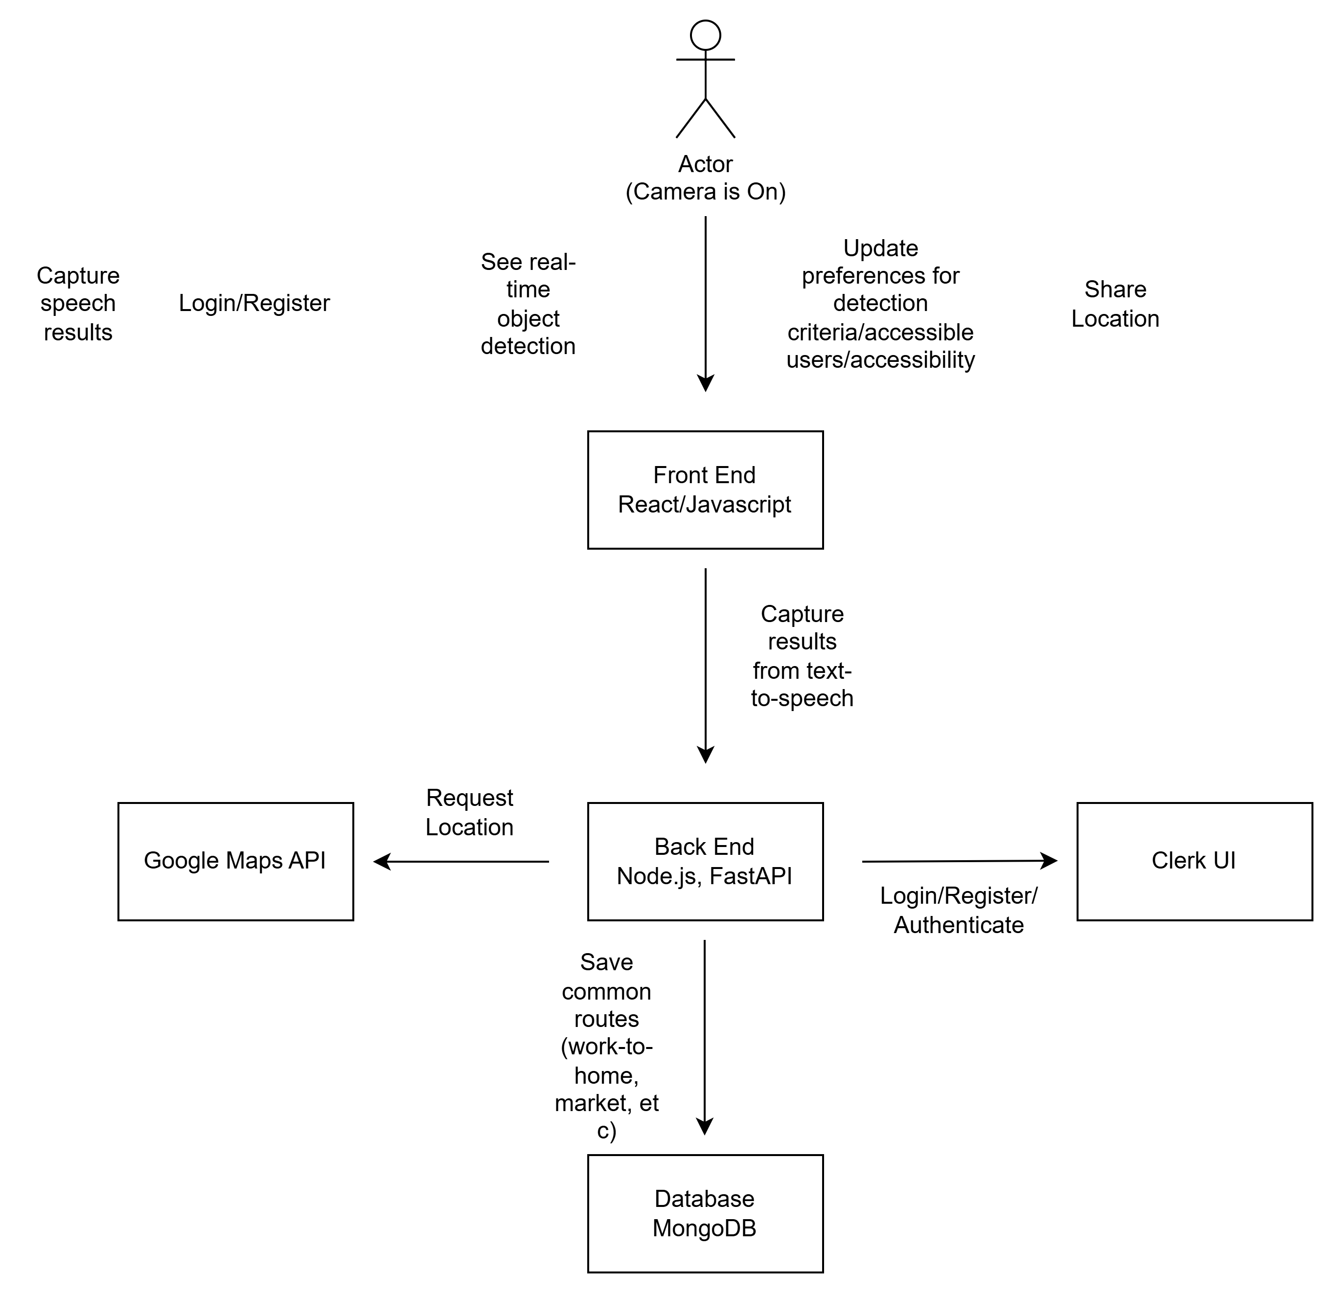
Architecture Diagram

Slide 21
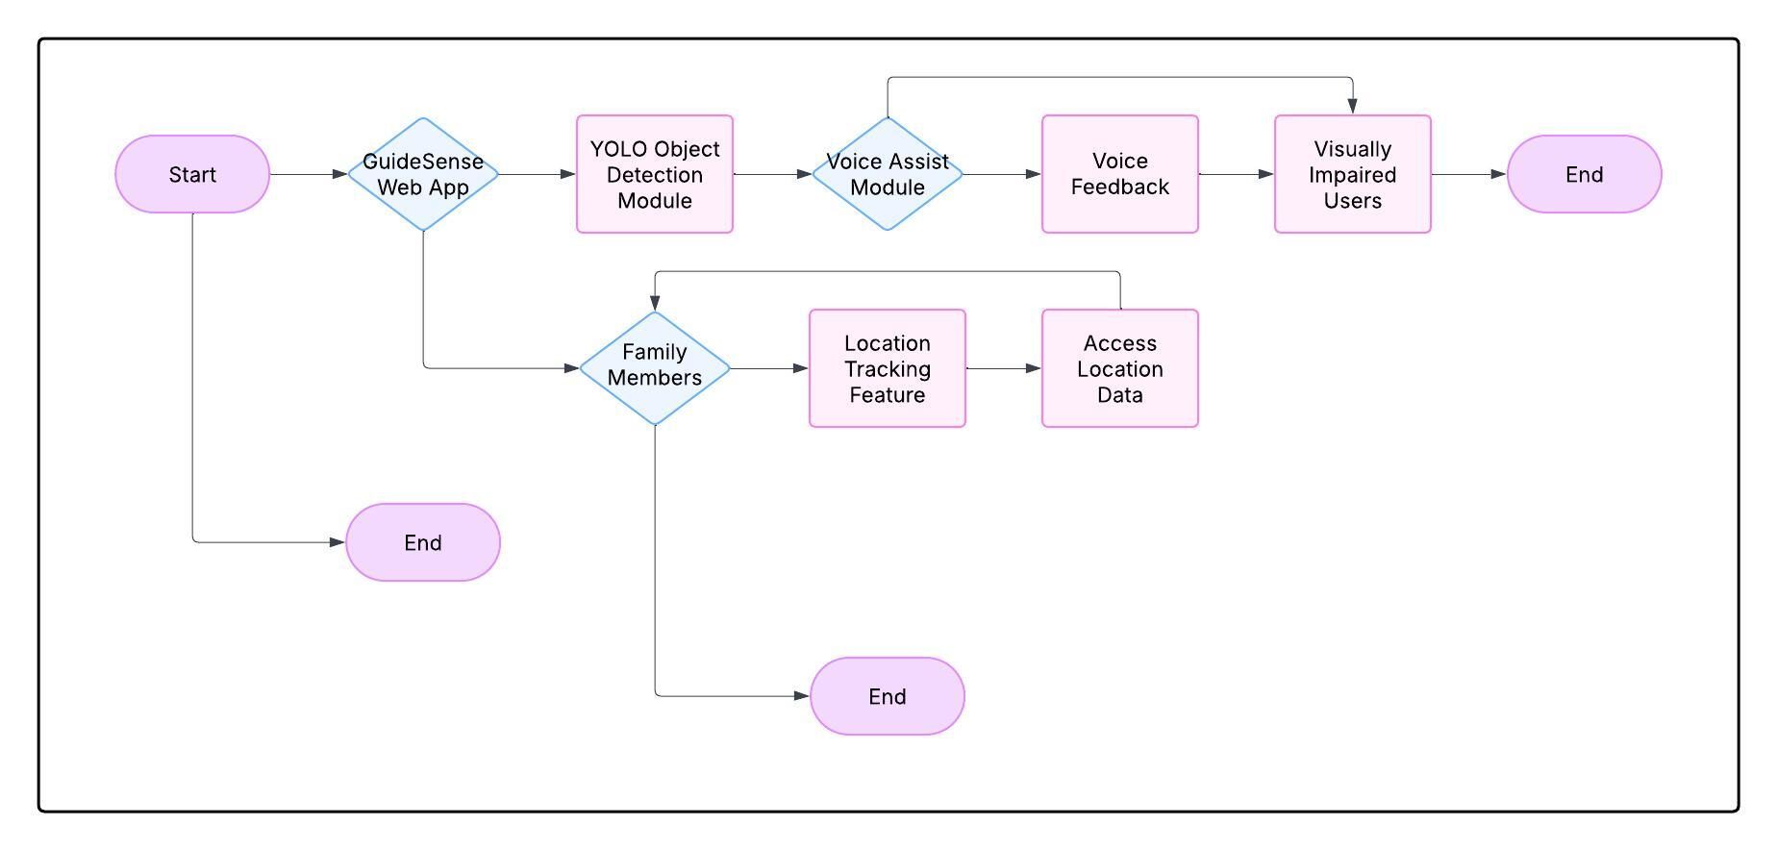
Context Diagram

Slide 22
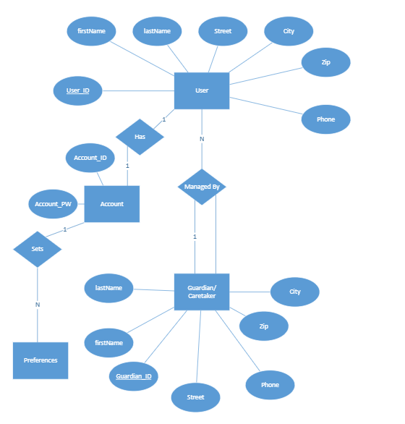
ER Diagram

Slide 23
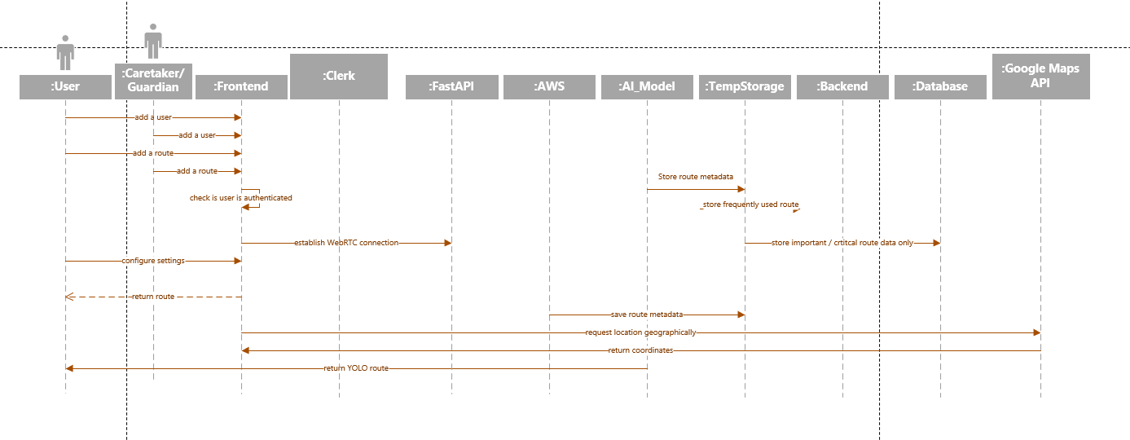
Sequence Diagram

Slide 24
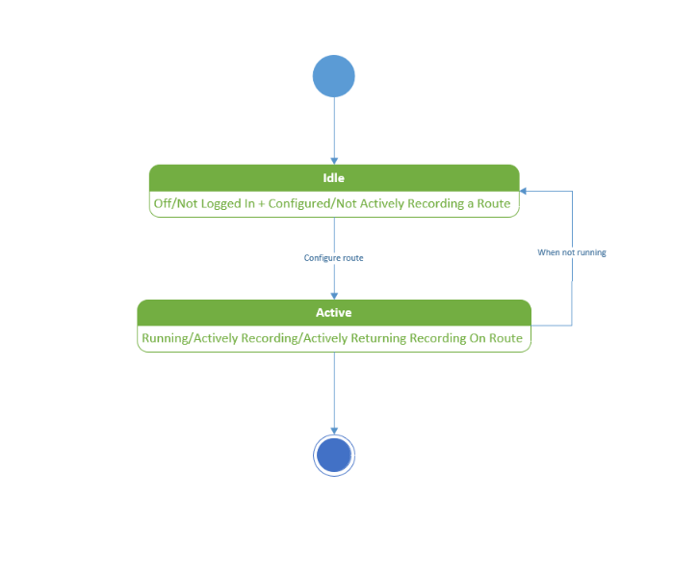
State Diagram

Slide 25
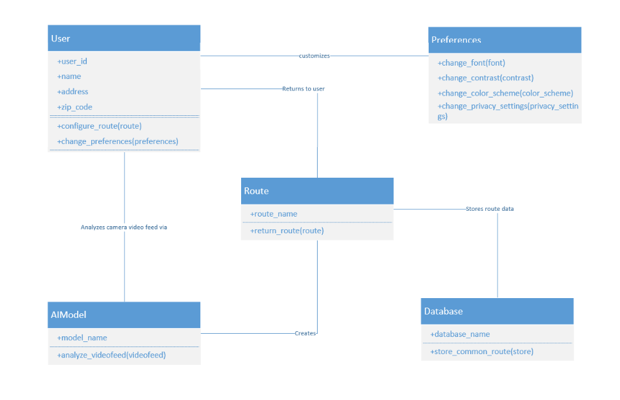
Class Diagram

Slide 26
Sprint 1 Recap
1
2
3
Implemented YOLO Module
Implemented Authentication
Designed application diagrams
4
Established services for database and server
5
Implemented Google Map API for route detection

Slide 27
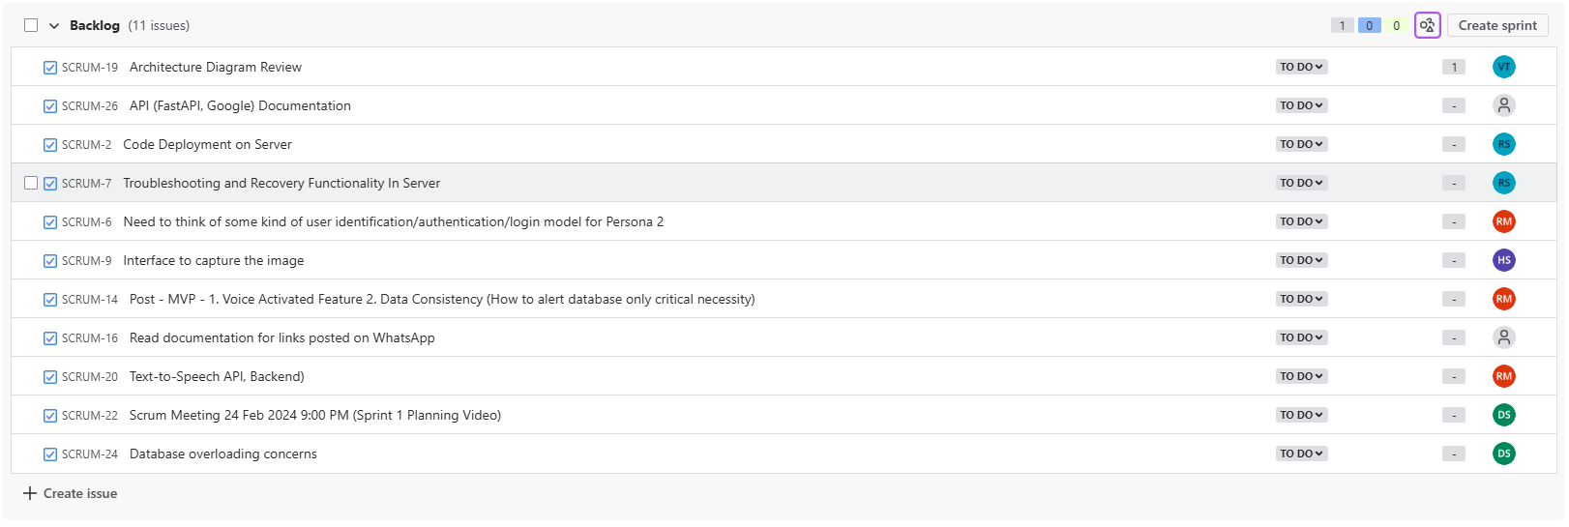
Product Backlog

Slide 28
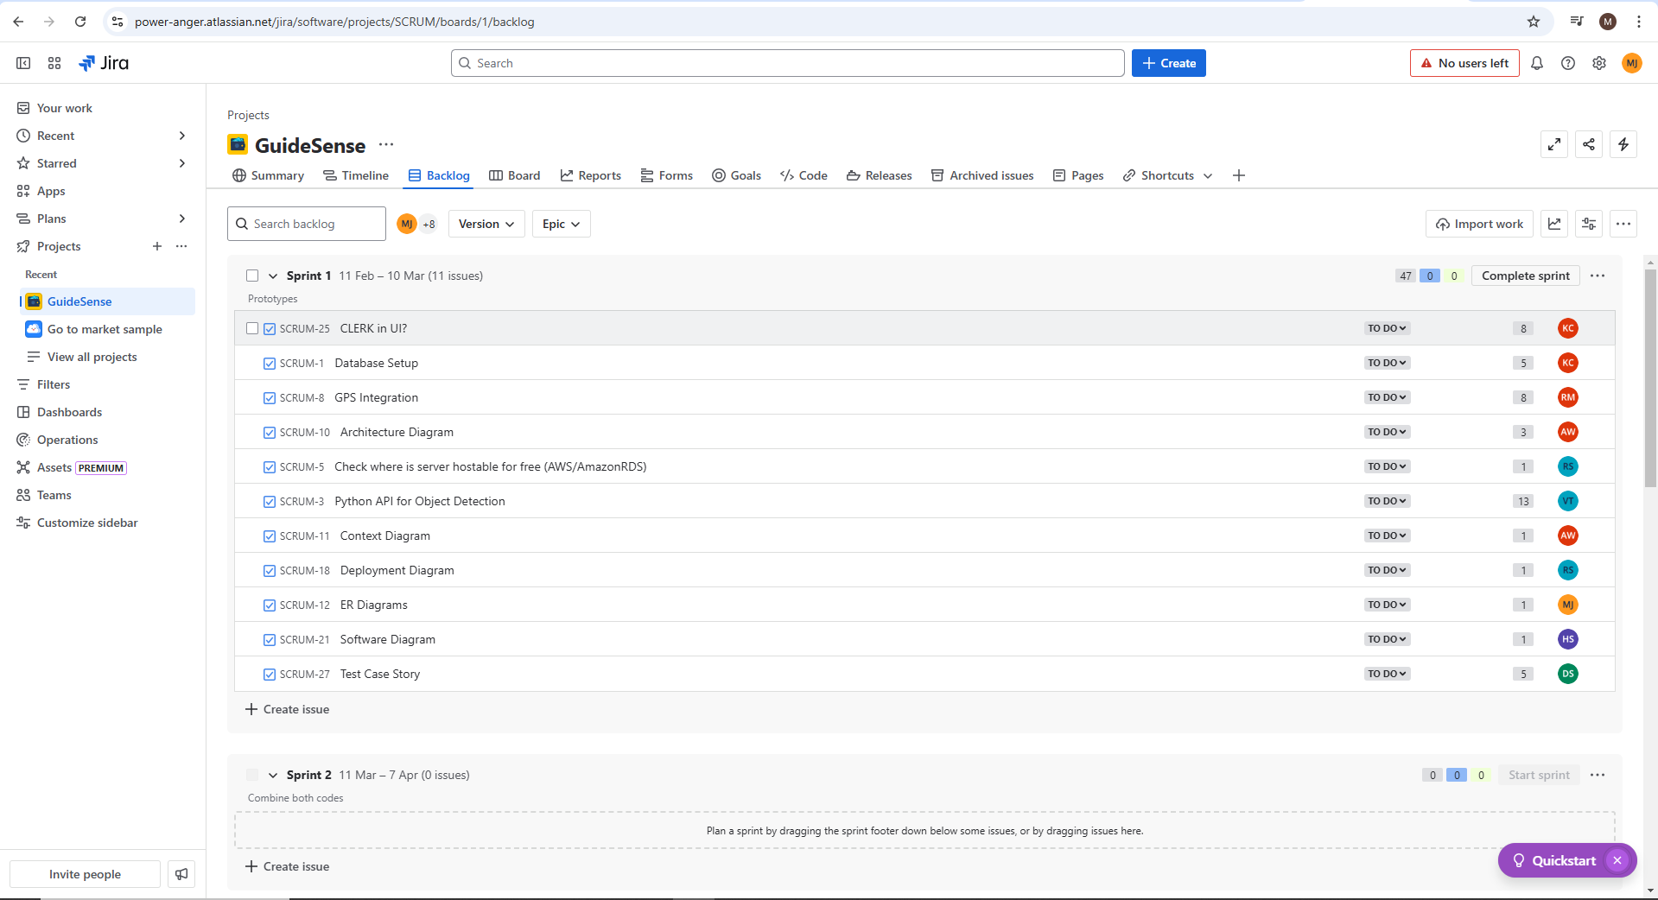
Sprint 1 – Sprint Planning

Slide 29
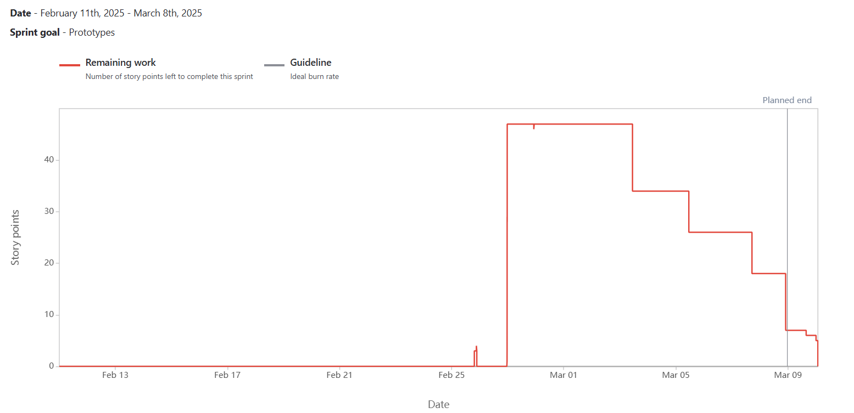
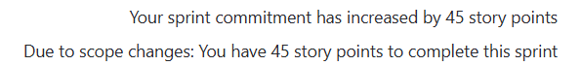
Sprint 1 – Burndown Chart
Notes:
Sprint burndown was completed as shown above. The total sprint commitment was 45 total story points. All issues in the sprint were completed.

Slide 30
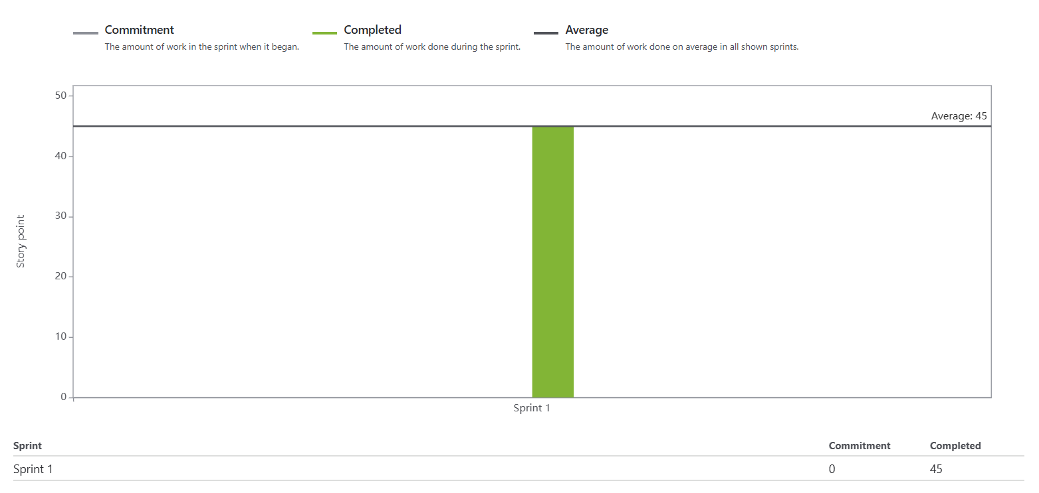
Sprint 1 – Team Velocity & Committed Ratio
Out of a total 45 committed story points, 45 story points were completed. The committed ratio is 100%.

Slide 31
Retrospective – Sprint 0
What went well?
What need to improve
Action Items
Everyone was active on Whatsapp
Everyone collaborated in coming up with project ideas
Respected each other's opinions
Team coordination was good
Calls frequency and participation
Need to document what everyone is doing
Everyone needs to speak during the meeting.
Schedule a zoom call and add it in our calendar
Setup Jira for Project management.
Start early for sprint 1

Slide 32
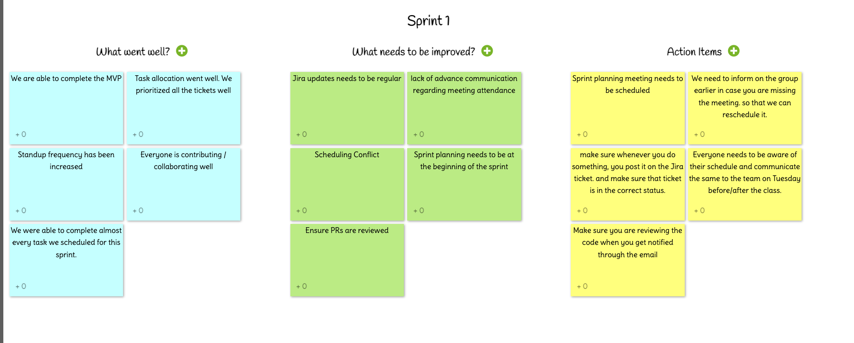
Retrospective – Sprint 1

Slide 33
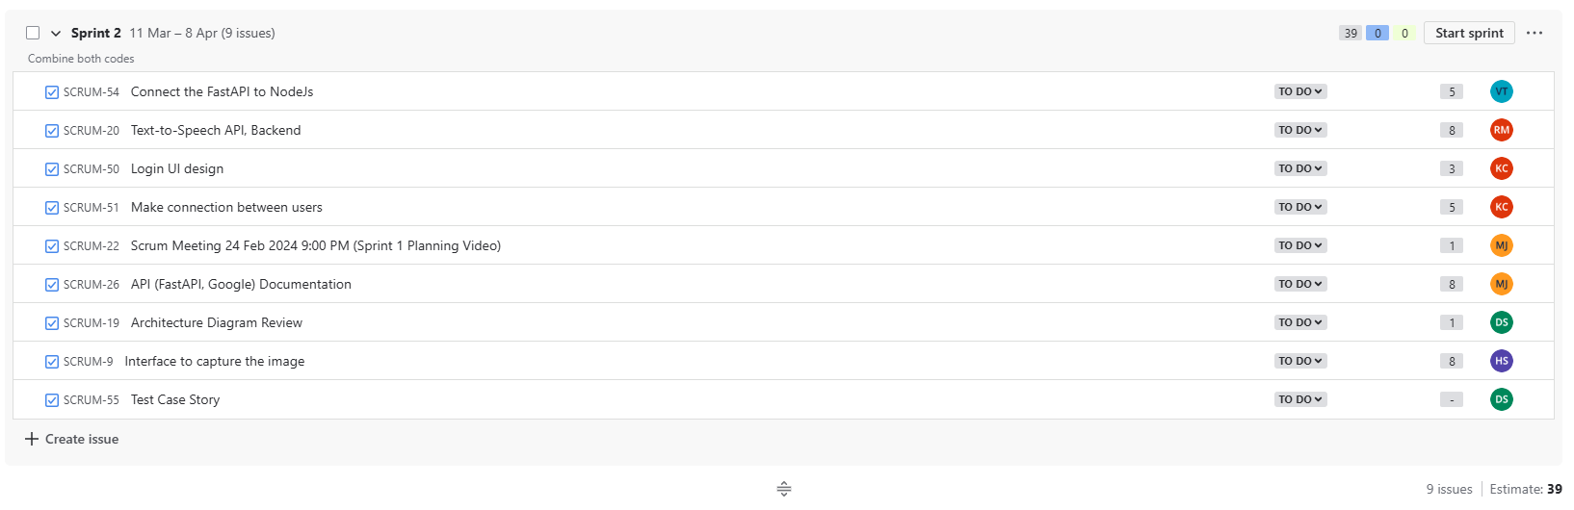
Sprint 2 – Sprint Planning

Slide 34
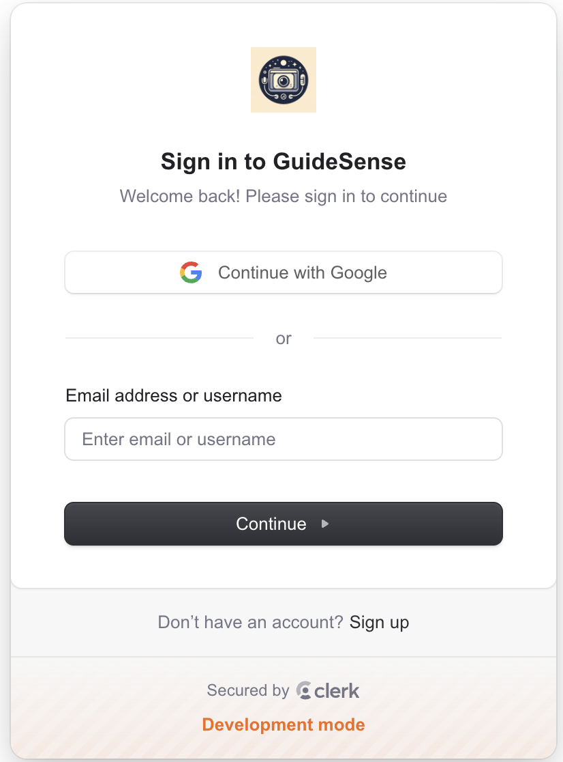
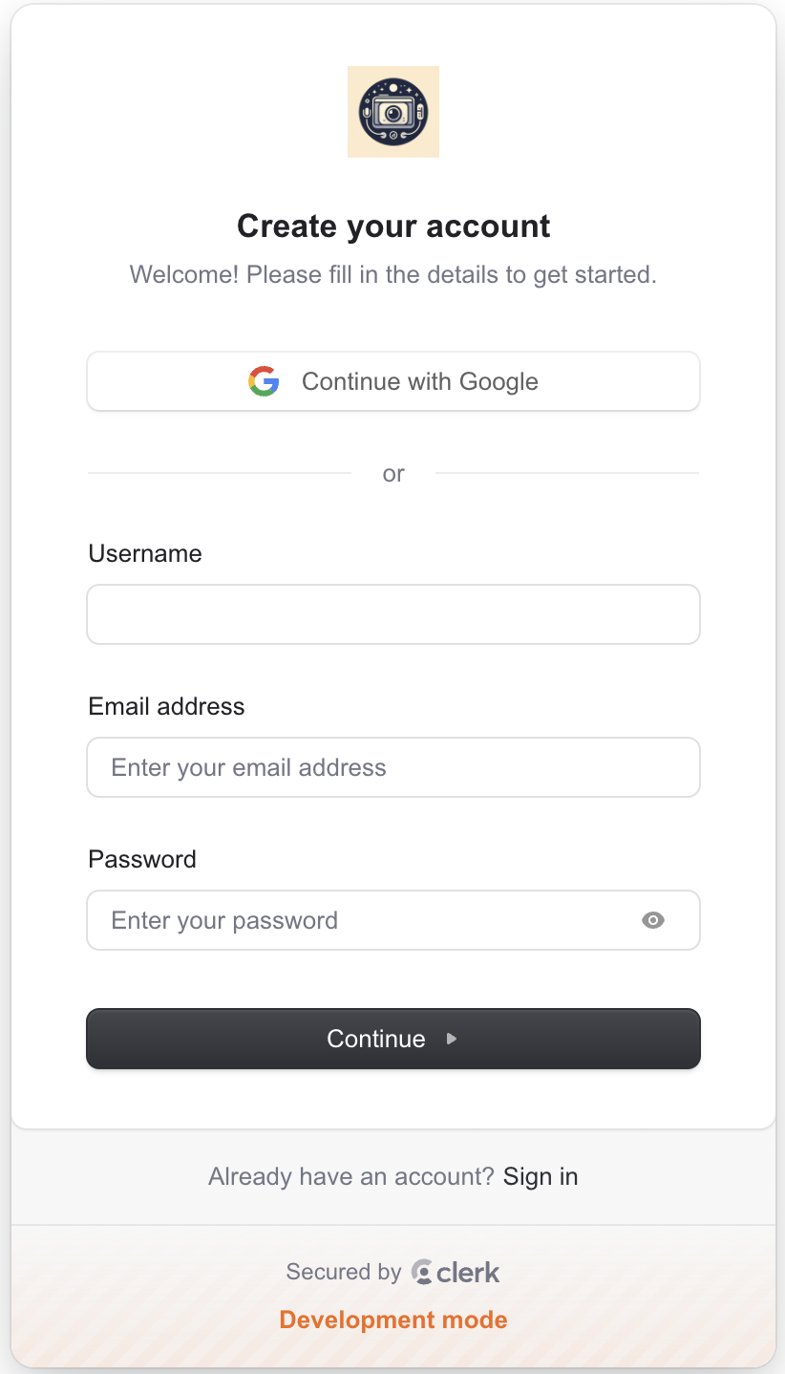
Sprint 1 – Project Demo

Slide 35
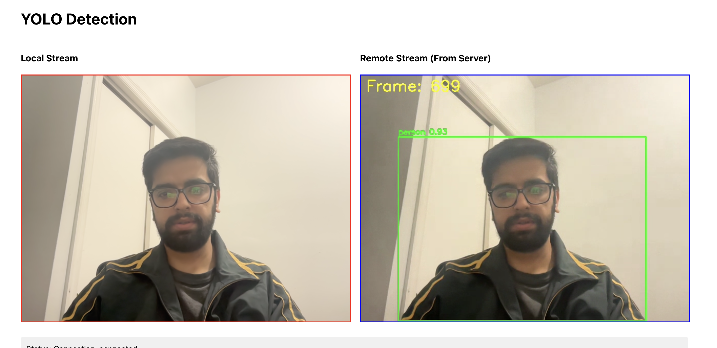
Sprint 1 – Project Demo

Slide 36
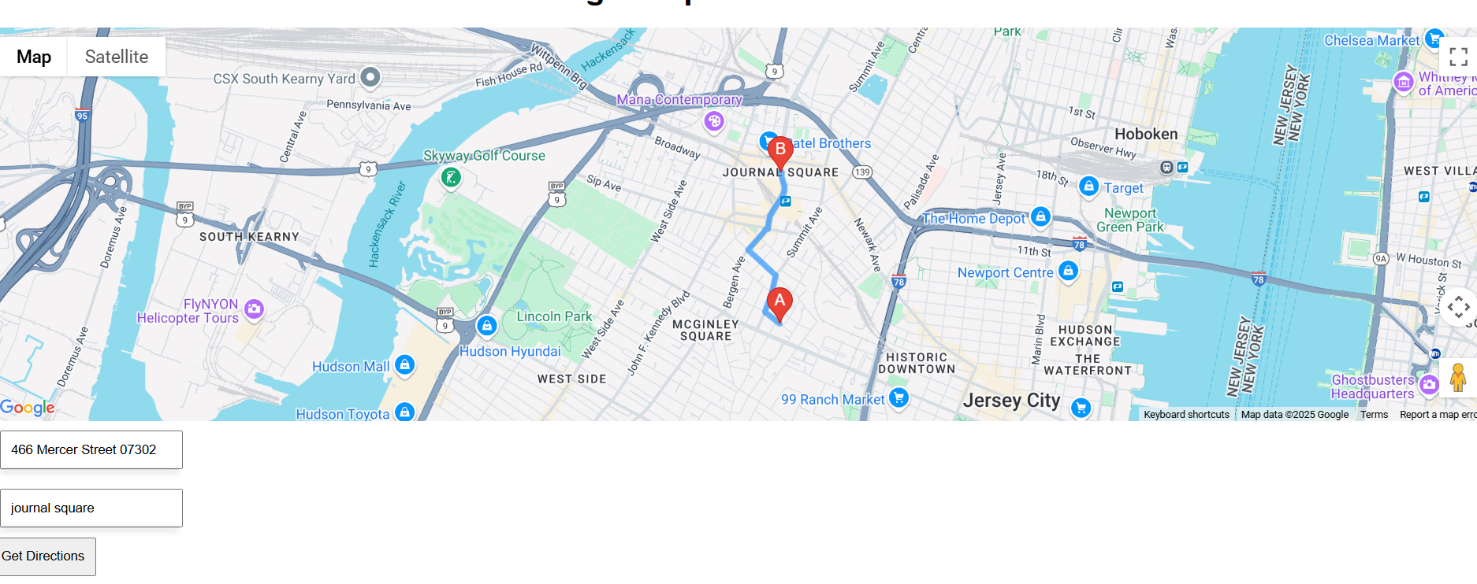
Sprint 1 – Project Demo

Slide 37
https://github.com/htmw/2025S-Power-Anger/wiki
Project Wikipage Link

Slide 38
Live Application Demo

